Slide 1
Debugging in C#

Slide 2


Debugging
Debugging is the process of finding errors during application execution. It does not mean syntax errors with which the application cannot be compiled, but on logical errors.
Debugging is also used by developer if they want to know the overall flow of the code or application.

Slide 3
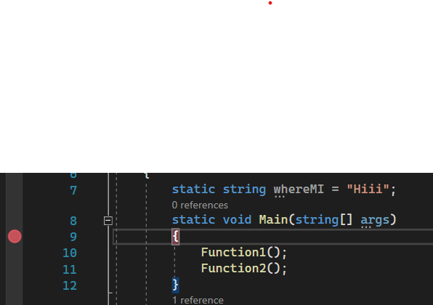
Breakpoints
The first thing to do in debugging is to add breakpoint.
When you debug, execution pauses at the breakpoint before the code on that line is executed.

Slide 4
Some important tools in debugging
STEP INTO (F11)
Executes the current statement and stops at the next statement. If the current statement is a function or a script call, then the debugger steps into that function or script, otherwise it stops at the next statement
STEP OVER (F10)
Executes the current statement and stops at the next statement. If the current statement is a function or a script call, then the debugger executes the whole function or script rather than going into the function
STEP OUT (shift + F11)
Steps out of the current function and up one level if the function is nested. If in the main body, the script is executed to the end, or to the next breakpoint. The skipped statements are executed, but not stepped through

